Slide 1
Keeper of Records Report
Mark A. Gallashaw, Sr.
SWP Keeper of Records

Slide 2
What’s Going on in the Southwestern Province
Brothers, the Southwestern Province leads Kappa Alpha Psi with using technology advances.
Our e-Certification Program was a success in making our certification process almost paperless.
Then we implemented e-Credentials Program. There were some mixed signals when we sent out the credential forms, but the e-Certification is working, I got a lot of submissions. We need to continue using these methods to get things done better and faster.
I want to thank “Brother Ryan Gilner” for implementing and for making sure these programs are on the province website for us to use.

Slide 3
Keeper of Records Reference Checklist
1 | Grand Board Directory | 11 | Schedule of Graduates Form
2 | Southwestern Province Polemarch Directory | 12 | Chapter Invisible Form
3 | Chapter Directory | 13 | Chapter Reinstatement Policy
4 | National Chapter Advisors’ Committee List | 14 | Chapter Evaluation Form
5 | Code of Conduct | 15 | Statement of Collaboration Form
6 | Chapter Certification Criteria Form | 16 | Personal Liability, Responsibility & Compliance
7 | Undergraduate and/or Alumni Officers Report | 17 | Chapter Tax Schedule A & B Form-Keeper of Records
8 | Bible | 18 | Award Petitions and Instructions
9 | Rituals (not copies but bounded books) | 19 | Executive Director’s Bulletin
10 | Officers insignia | 20 | Kappa Alpha Psi Fraternity, Inc. Journal

Slide 4
Keeper of Records Reference Checklist (Continue)
21 | Kappa Insurance Plan-Chapter and Province | 25 | Grand Conclave Chapter Voting Credential Form (conclave year)
22 | Province Registration Form | 26 | Membership Orientation Intake Program (Workbook) Manual
23 | CRWLC Registration Form | 27 | Membership Orientation Manual
24 | Grand Chapter Registration Form (Conclave year)

Slide 5
Types of Reports and Items Required for Effective Chapter Management
TYPE OF REPORT/ITEM DUE | DUE DATE | WHO TO SEND TO
Election of Officers (Undergrad) | March 1 | IHQ
Election of Officers (Alumni) | May 30 | IHQ
Officers Report (Undergrad) | October 31 | IHQ
Officers Report (Alumni) | June 30 | IHQ
Chapter Membership Report | March 30 | IHQ
Tax Report (IRS Form 990N) Long or e-Post Card | Annually (1 October) | IHQ
National Membership Dues | October 1 | IHQ
Provincial Membership Dues | October 1 | SWP KOE
Province Chapter Dues | Province Certification Deadline | SWP KOE

Slide 6
Types of Reports and Items Required for Effective Chapter Management
TYPE OF REPORT/ITEM DUE | DUE DATE | WHO TO SEND TO
Regular Formal Meeting (Undergrad) | Per Semester | Retained by Chapter KOR
Regular Formal Meeting (Alumni) | Per month | Retained by Chapter KOR
Grand Chapter Delegate Registration Fee | Every 2 years | IHQ
Provincial Delegate Registration Fee | Annually March/April | SWP KOE
CRWLC Delegate Registration Fee | Annually September | SWP KOE

Slide 7
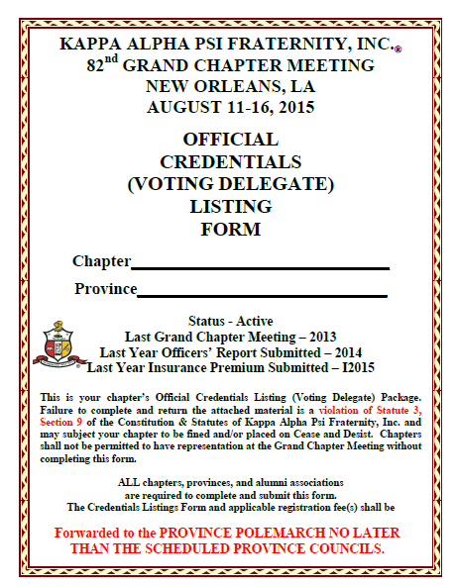
Instruction for completing
the
credentials
Each Chapter has a unique ID Number given to it by IHQ.
That ID should go in front of the Chapter Name:
597-C Lake Charles (LA) Alumni
Southwestern

Slide 8
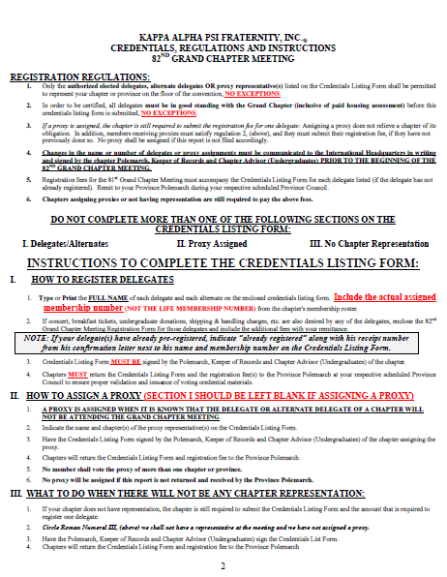
Instruction for completing
the credentials
Pay close attention to the requirements,
Do not assign number of votes to the delegates.

Slide 9
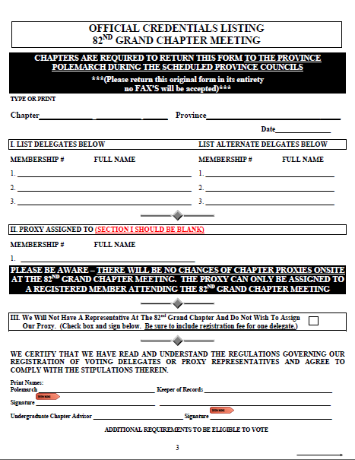
Instruction for completing
the
credentials
All individuals named as delegates including Alternates on the Credentials must be pre-registered before the credentials are submitted.
If any members assigned on the credentials is not pre-registered at the time the credentials is submitted to IHQ, the credentials will be rejected and returned to the province for correction.
The Chapter Polemarch and Keeper of Records must print their names and sign the credentials. If an Undergrad Chapter, the advisor must also sign the credentials.
597-C Lake Charles (LA) Alumni
Southwestern
02/02/2015
20050889 Mark A. Gallashaw, Sr.

Slide 10
Instruction for completing
the
credentials
If the chapter submits the form with a proxy assigned. No names will be put in the “List Delegates” Section or the “List Alternates” Section of the credentials.
The Chapter Polemarch and Keeper of Records must print their names and sign the credentials. If an Undergrad Chapter, the advisor must also sign the credentials.
597-C Lake Charles (LA) Alumni
Southwestern
02/02/2015
20050889 Mark A. Gallashaw, Sr.

Slide 11
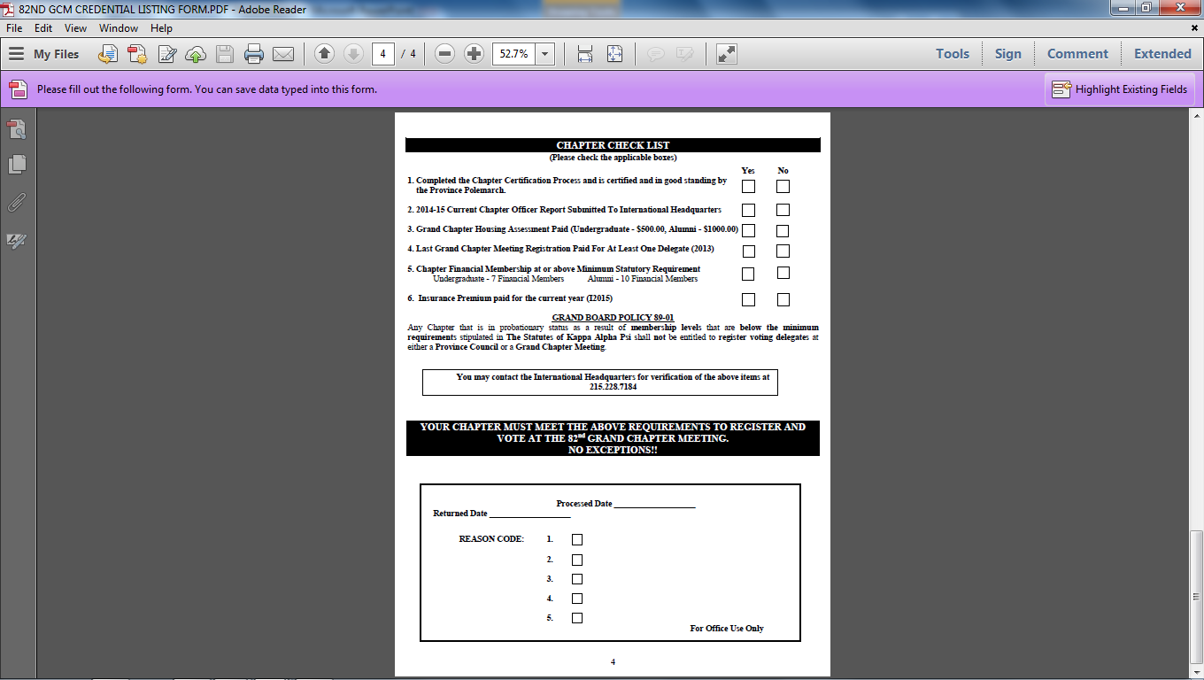
Instruction for completing
the
credentials
Check all appropriate boxes that apply and Upload to the Province Website.

Slide 12
Chapter Tax Exempt ID Applications
Brothers, if your chapters has submitted their application for reinstatement and you need to keep the Province informed of the status of your application.
If you have not submitted your chapters application to the IRS, you need to get with me to get the application and submit it ASAP to the IRS with a check or money order for the amount of $100.00
If you need help filling out the forms, please contact me for help.

Slide 13
Brothers, if you need my assistance, here’s how to reach me.
My Contact information is:
Mark A. Gallashaw
1707 Charlotte Drive
DeRidder, LA 70634
337-348-9059
markgallashawswpkor@gmail.com

