Slide 1
Kappa Alpha Psi Fraternity, Incorporated
Southwestern Province
90th Southwestern Province Council
2025-2026 SWP Chapter
Certification Report
Presented by Keith Campbell
Director of Organizational Effectiveness

Slide 2

Chapter Statistics
115 Total Chapters Certified
53 Undergraduate Chapters (+3 from 2025)
62 Alumni Chapters (+0 from 2025)
1 Alumni Association Certified *

Slide 3
First Chapters Fully Certified (Alumni)
Killeen (TX) Alumni – 10/01/2025
Lafayette (LA) Alumni – 10/01/2025
Hattiesburg (MS) Alumni – 10/02/2025
New Braunfels (TX) Alumni – 10/02/2025
San Antonio (TX) Alumni – 10/05/2025
Arlington-Grand Prairie (TX) Alumni – 10/6/2025
Frisco (TX) Alumni – 10/06/2025
Alexandria (LA) Alumni – 10/06/2025

Slide 4
First Chapters Fully Certified (Undergraduate)
Gamma Sigma – 10/01/2025
Xi Sigma – 10/04/2025
Epsilon Nu – 10/09/2025
Alpha Chi – 10/10/2025

Slide 5
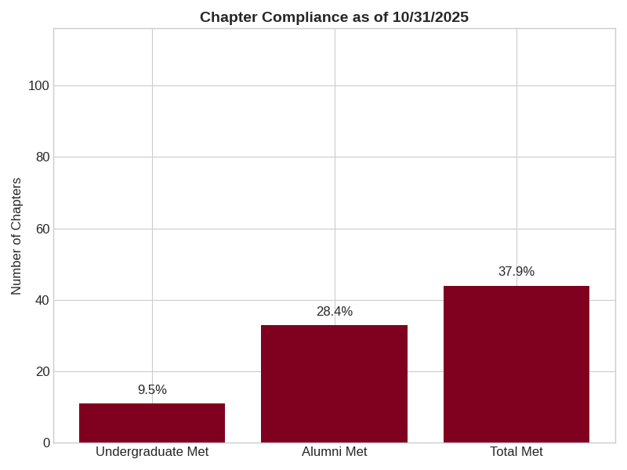
Meeting the Deadline – How did we do?

Slide 6
Reminders
  Adhering to Deadlines is critical
  Chapter Leadership – Know your status
  Assist the Undergraduate Chapters
  Communicate with your Administrative Assistant

Slide 7
Acknowledgements
“The Dream Team”
Administrative Assistant | Area | Email | Phone
Brian Pickett | North Arkansas | blpickett2001@icloud.com | 501-944-1413
Ray Walker | South Arkansas | rwalker@littlerock.gov | 870-692-4713
Cory Murphy | North Mississippi | murphycorym@gmail.com | 601-540-8669
C. Jermaine Brown | South Mississippi | cjermainebrown@gmail.com | 601-325-1003
Christopher Butler | East Texas | christopher_butler@sbcglobal.net | 972-345-4429
Marcus Anderson | North Texas | marcus.t.anderson.1911@gmail.com | 601-408-1629
Ron Lockett | Southeast Texas | rjlock@hotmail.com | 281-772-0185
Fred Corbin | South Central Texas | fbcorbin5@aol.com | 804-301-2648
Micheal Gunn | West Texas/ New Mexico | micheal.gunn@ttu.edu | 806-577-9142
Kobie Guillory | Southeast Louisiana | kjguillory73@gmail.com | 504-231-1702
Kenneth Wright | Southwest Louisiana | kwright5894@gmail.com | 225-907-7983
Karl Nero | North Louisiana | kwnero@bellsouth.net | 318-547-7743

Slide 8
Contact Information
Keith Campbell
(972)849-4742
organizational@southwesternprovince1911.org
kcnupe12@gmail.com

