Slide 1
Kappa Alpha Psi Fraternity, Incorporated
Southwestern Province
90th Southwestern Province Council
MEMORIAL SERVICE

Slide 2
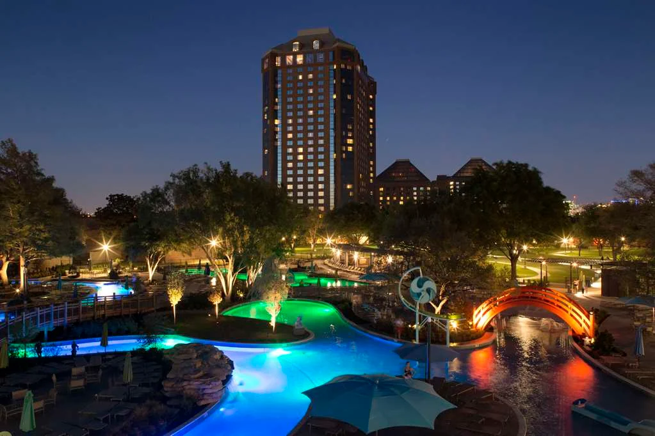

Brother Christopher Adam
Beta Upsilon
Brother Terry Alexander
Camden-Magnolia-El Dorado (AR) Alumni
Brother Joseph Antoine, Jr.
Theta Nu

Slide 3
Brother Jackson Bailey
Zeta Beta
Brother Kendall Banks
Theta Nu
Brother Quincy Beavers, Jr.
Gamma Psi

Slide 4
Brother Bryant Benoit
Theta Nu
Brother Solomon Birdsong
Shreveport (LA) Alumni
Brother Thomas Broussard
Baton Rouge (LA) Alumni

Slide 5
Brother Mark Brown
Zeta Upsilon
Brother Benjamin Brown
Gamma Rho
Brother Raymond Brown
Beta Upsilon

Slide 6
Brother Louis Bryan
Gamma Rho
Brother Zachary Burks
Pine Bluff (AR) Alumni
Brother Tony Carter
Gamma Sigma

Slide 7
Brother Andre Clark
Theta Mu
Brother Edward Coleman
Beta Tau
Brother Edwin Creech
Epsilon Pi

Slide 8
Brother Tavarris Cross
Zeta Zeta
Brother Christon Currie
Prairie View (TX) Alumni
Brother Larry Duke
Epsilon Pi

Slide 9
Brother Michael Edwards
Eta Phi
Brother Cleveland Farlough
Alpha Sigma
Brother Charles Getwood, Sr.
Port Arthur (TX) Alumni

Slide 10
Brother Willie Goffney
Zeta Beta
Brother Billy Golston
Zeta Upsilon
Brother Alphonso Goode
Beta Beta

Slide 11
Brother Allen Green
Little Rock (AR) Alumni
Brother Huey Hill
Gretna (LA) Alumni
Brother Eric Hoard
Theta Epsilon

Slide 12
Brother Rufus Hollis
Zeta Xi
Brother Jordan Holt
Gamma Pi
Brother Randy Howard
Opelousas (LA) Alumni

Slide 13
Brother Phillip Hudson
Dallas (TX) Alumni
Brother Demetrice Hunter
Xi Sigma
Brother Bobby Jackson
Beta Beta

Slide 14
Brother Don James
Beta Gamma
Brother John Johnson
Delta Delta
Brother Pattrone Jones
Houston (TX) Alumni

Slide 15
Brother Kenneth Jordan
Gamma Sigma
Brother George Key
Zeta Beta
Brother James Langley
Gamma Sigma

Slide 16
Brother Robert LeGrand, Jr.
Fort Worth (TX) Alumni
Brother Tarance Lenoir
El Paso-Las Cruces (TX) Alumni
Brother Howard Love, Jr.
Gamma Sigma

Slide 17
Brother Alvin Matthews
Austin (TX) Alumni
Brother Marlon Messer
Lambda Kappa
Brother Chris Montgomery
Beta Iota

Slide 18
Brother Leonard O’Neal
Theta Epsilon
Brother Valerian Owens
Theta Nu
Brother Terance Petitt
Eta Tau

Slide 19
Brother Kobe Poole
Nu Alpha
Brother Charles Porch, Jr.
Theta Epsilon
Brother Byron Pratt
Gamma Psi

Slide 20
Brother Christopher Price, Jr.
Lake Charles (LA) Alumni
Brother Morman Richard
Eta Upsilon
Brother Elbert Robinson
Shreveport (LA) Alumni

Slide 21
Brother Willie Robinson
Delta Delta
Brother Gilbert Saulter
Dallas (TX) Alumni
Brother Von Shelton, Sr.
Delta Sigma

Slide 22
Brother Willie Short
Jackson (MS) Alumni
Brother J. Smith
Epsilon Pi
Brother Reginald Sutton
Eta Lambda

Slide 23
Brother George Swaggard, Jr.
Fort Worth (TX) Alumni
Brother Lee Thomas
Gamma Psi
Brother Donald Thomas
Theta Nu

Slide 24
Brother Donald Turner
Shreveport (LA) Alumni
Brother Taj Warren
Lambda Lambda
Brother Edward Watson
Theta Alpha

Slide 25
Brother Vernon Williams
Alpha Sigma
Brother Edward Williams
Shreveport (LA) Alumni
Brother George Williams, II
Eta Lambda

Slide 26
Brother Paul Williams
Alexandria (LA) Alumni
Brother Tommie Wyatt
Delta Sigma

Slide 27
Kappa Alpha Psi Fraternity, Incorporated
Southwestern Province
90th Southwestern Province Council
GONE, BUT NOT FORGOTTEN …

